Slide 1



AcF 304 Financial Markets
Topic 6: The Money Markets
Part 1 – Money Markets Intro
Notes:
If this PowerPoint presentation contains mathematical equations, you may need to check that your computer has the following installed:
1) MathType Plugin
2) Math Player (free versions available)
3) NVDA Reader (free versions available)

Slide 2

Financial Markets and Institutions
Ninth Edition, Global Edition
Reading – Chapter 11 The Money Markets
Notes:
If this PowerPoint presentation contains mathematical equations, you may need to check that your computer has the following installed:
1) MathType Plugin
2) Math Player (free versions available)
3) NVDA Reader (free versions available)

Slide 3
Now that’s a lot!
In its 2018 annual report, Alphabet (Google) listed $58 billion in short-term securities on its balance sheet, plus $14 billion in actual cash equivalents. Alphabet does not keep this in its local bank. But where?
This is, of course, topic 6 — Money Markets.

Slide 4
Topic Preview
We review the money markets and the securities that are traded there. In addition, we discuss why the money markets are important in our financial system. Topics include:
The Money Markets Defined
The Purpose of Money Markets
Who Participates in Money Markets?
Money Market Instruments
Comparing Money Market Securities
Part 4 – A Day in The Life of a Trader

Slide 5
The Money Markets Defined (1 of 2)
The term “money market” is an inaccurate term. Money (currency) is not actually traded in the money markets.
The securities in the money market are short term with high liquidity; therefore, they are close to being money.

Slide 6
The Money Markets Defined (2 of 2)
Money Markets Defined
Usually sold in large denominations ($1,000,000 or more - 10 MM, 20 MM or 50 MM common)
Low default risk
Mature in one year or less from their issue date, although most mature in less than 120 days
OTC (electronically over the phone)
Active secondary market

Slide 7
The Money Markets Defined: Why Do We Need Money Markets?
In a totally unregulated world, the money markets should not be need.
The banking industry should handle the needs for short-term.
Banks have an information advantage.
Banks, however, are heavily regulated.
Creates a distinct cost advantage for money markets over banks.

Slide 8
The Money Markets Defined: Money Market Cost Advantages
A ceiling on the rate of interest might create expense for banks that money markets do not have.
Limits on interest banks could offer was not relevant until the 1950s. In the decades that followed, the problem became apparent.
When interest rates rose, depositors moved their money from banks to money markets.
Regulations on the level of interest banks could offer depositors lead to a significant growth in money markets, especially in the 1970s and 1980s.

Slide 9
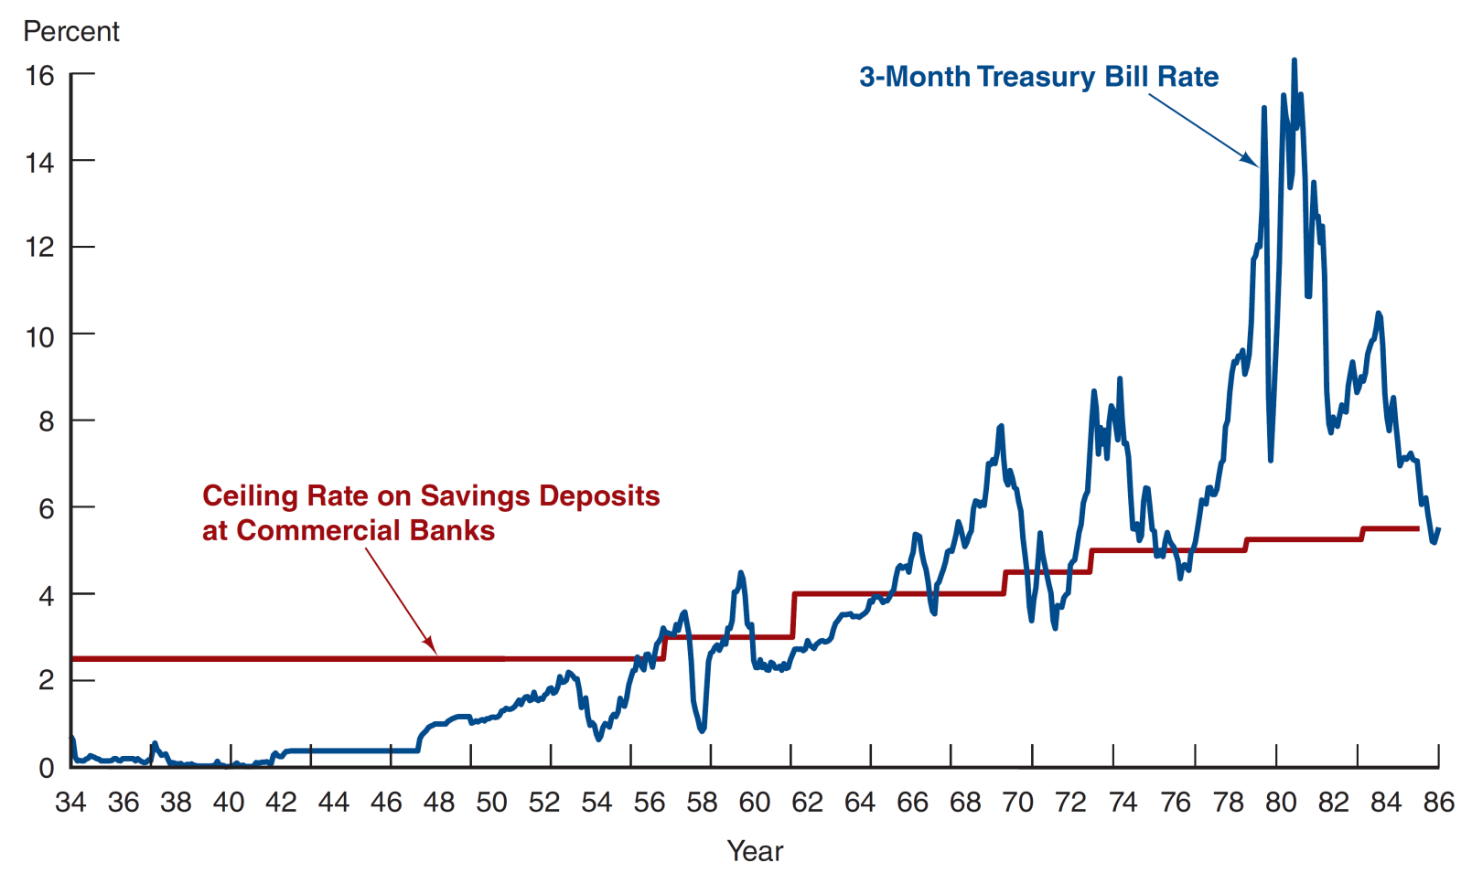
Figure 11.1 Three-Month Treasury Bill Rate and Ceiling Rate on Savings Deposits at Commercial Banks, 1933 to 1986
Source: http://www.stlouisfed.org/default.cfm.

Slide 10
The Purpose of Money Markets (1 of 2)
Investors (buyers): the money market provides a place for warehousing surplus funds for short periods of time
The goal is not to earn very high return but a higher return than holding cash or money in banks (in other words, reduce opportunity costs).
Borrowers (sellers): the money marker provides a low-cost source of temporary funds.
Commercial banks borrow excess reserves to meet short-term reserve requirement shortages.

Slide 11
The Purpose of Money Markets (2 of 2)
The governments funds the U.S. debt by selling Treasury bills.
Corporations and U.S. government use these markets because the timing of cash inflows and outflows are not well synchronized.
Example: government tax revenues usually come only at certain times, but expenses are incurred all year
Money markets provide a way to solve these cash-timing problems.

Slide 12
Who Participates in the Money Markets?
We will discuss, in turn, each of the major borrowers and lenders in the money market.
First, let’s examine some of the current rates offered in the U.S. money markets.

Slide 13
Table 11.1 Sample Money Market Rates, May 13, 2016
Instrument | Interest Rate (%)
Prime rate | 3.50
Federal funds | 0.37
Commercial Paper | 0.55
London interbank offer rate | 0.44
Eurodollar | 0.48
Treasury bills (4 week) | 0.24
The prime rate (US) is the lowest rate at which money can be borrowed from commercial banks by non-banks e.g. mortgages, loans and credit cards. It typically tracks with the federal funds rate and is generally about 3% higher than the Federal Fund Rate.

Slide 14
Table 11.2 Money Market Participants (1 of 3)
Not Assessed
Participant | Role
U.S. Treasury Department | Sells U.S. Treasury securities to fund the national debt
Federal Reserve System (Fed) | Buys and sells U.S. Treasury securities as its primary method of controlling interest rates
Commercial banks | Buy U.S. Treasury securities; sell certificates of deposit and make short-term loans; offer individual investors accounts that invest in money market securities

Slide 15
Table 11.2 Money Market Participants (2 of 3)
Not Assessed
Participant | Role
Businesses (major corporations) | Buy and sell various short-term securities as a regular part of their cash management
Investment companies/investment banks e.g. Goldman Sachs, Morgan Stanley, Barclays Capital | Trade / ‘make a market’ in money market securities
Finance companies / banks (commercial leasing companies) | Lend funds to individuals by issuing MM securities / CP
Insurance companies | Maintain liquidity needed to meet unexpected demands e.g. Hurricane Sandy 2012

Slide 16
Table 11.2 Money Market Participants (3 of 3)
Not Assessed
Participant | Role
Pension funds | Buys U.S. Treasury securities (funding the national debt)
Money market mutual funds (US) / unit trusts (UK / Europe) (originated when inflation/ interest rates rose 1970s) | Allow small investors to participate in the money market by aggregating their funds to invest in large-denomination money market securities

Slide 17
AcF 304 Financial Markets
Topic 6: The Money Markets
Part 2 – Money Markets Instruments
Notes:
If this PowerPoint presentation contains mathematical equations, you may need to check that your computer has the following installed:
1) MathType Plugin
2) Math Player (free versions available)
3) NVDA Reader (free versions available)

